Slide 1
Welcome!!
Teachers and students to the presentation of Group 1.
SMS ONLINE

Slide 2
Project :
SMS Online
Group Member: Nguyen Tien Hien(Leader)
Vo Khanh Duy
Trao An Tien
Instructor: Mr.Nguyen Tran Nhat Kha

Slide 3
Table of contents
01
Introduction
02
Entity Relationship Diagram
03
Some pictures of the project
04
Result

Slide 4
Introduction
Short Messaging Service(SMS ) online allows individuals
to send and receive messages on the website once they have
an account.
It also provide option for activating the service for the joke, current affairs, sports, news in your mobile, this would be paid service where user has to pay through credit card.

Slide 5
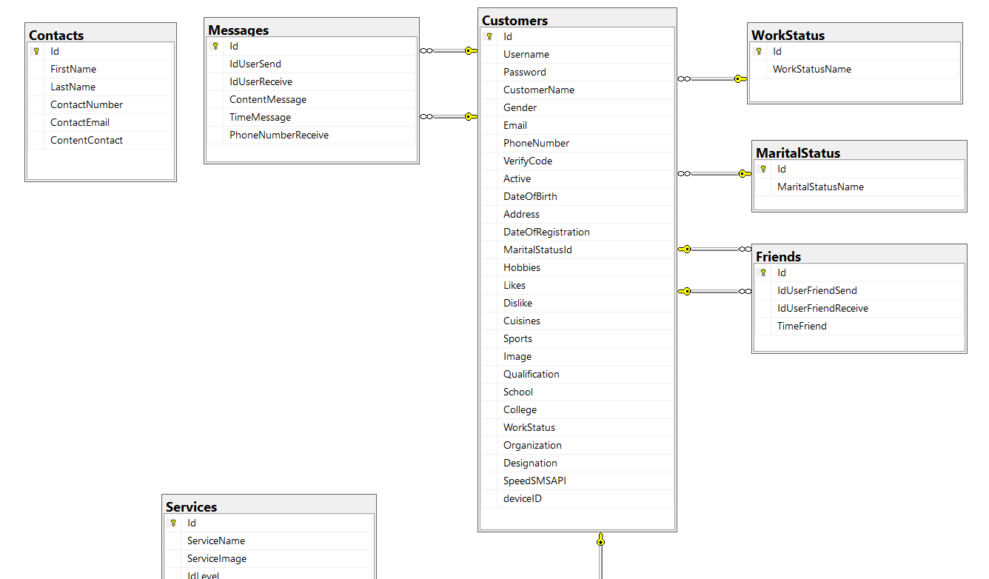
Entity Relationship Diagram

Slide 6
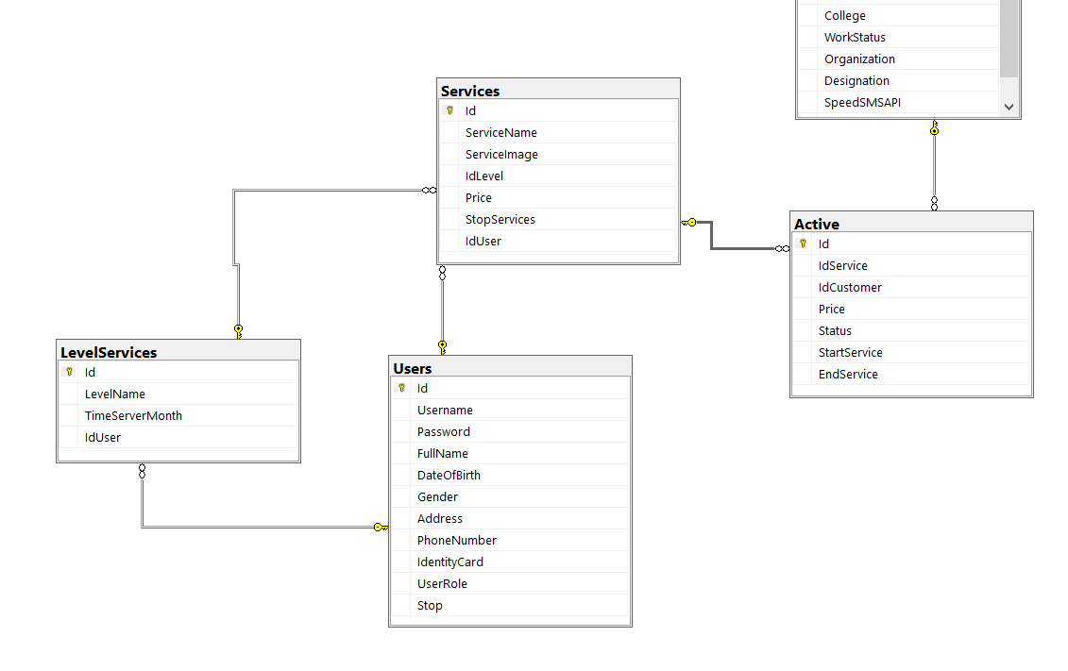

Slide 7
Some pictures of the project

Slide 8
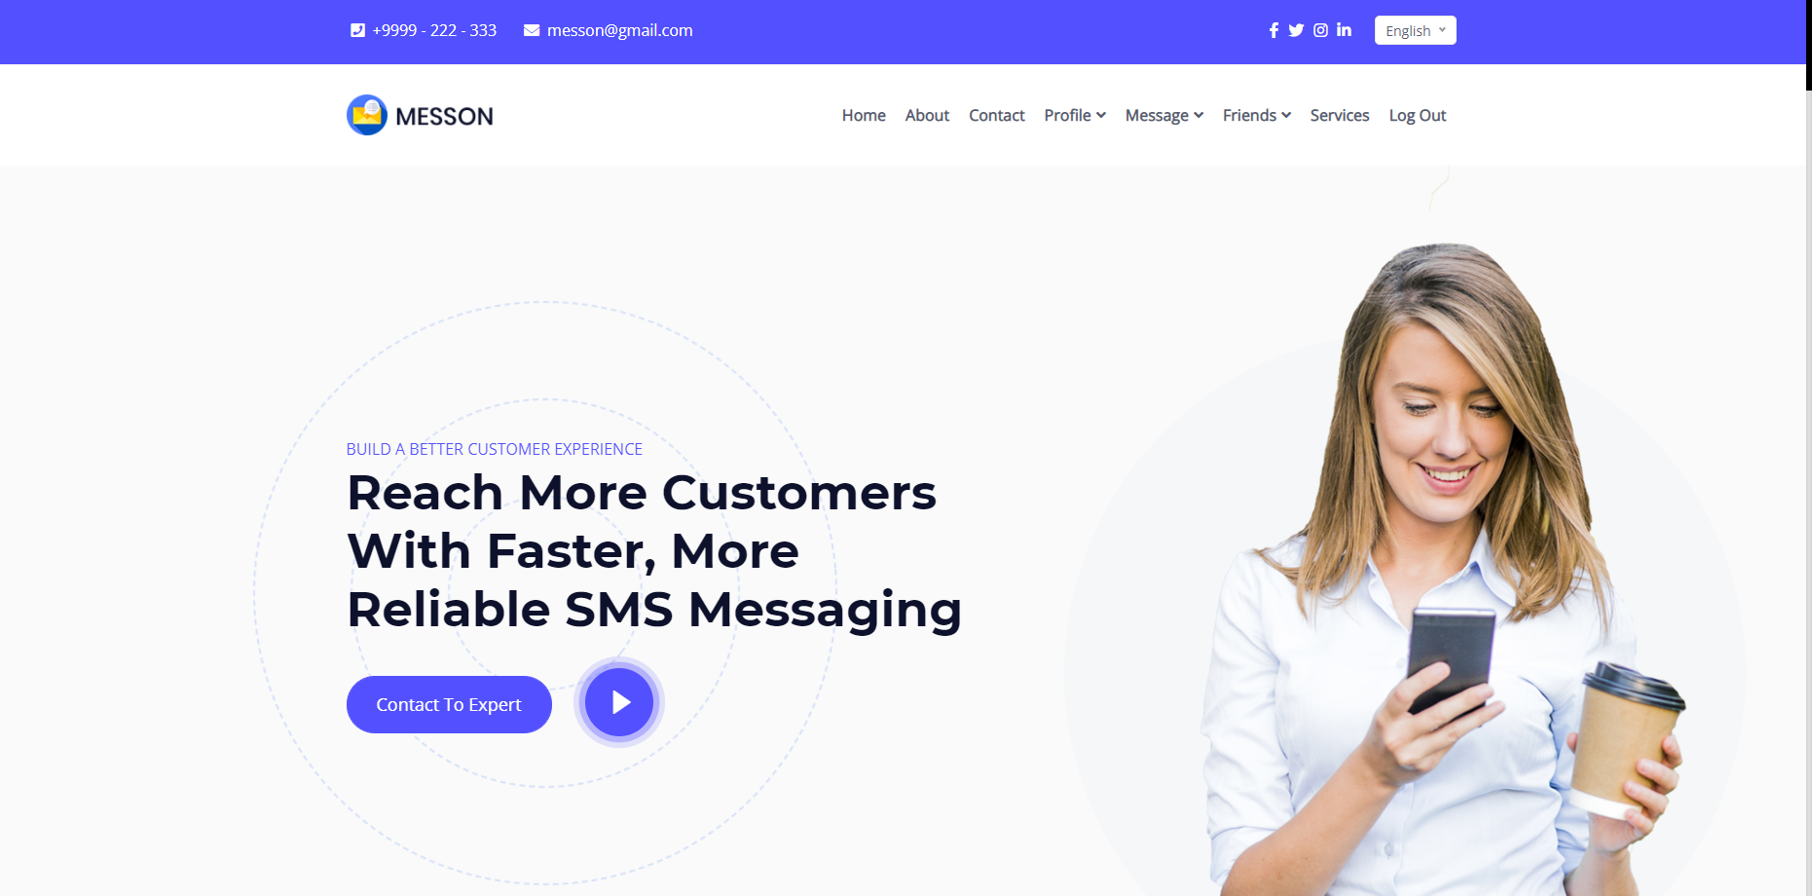
Home

Slide 9
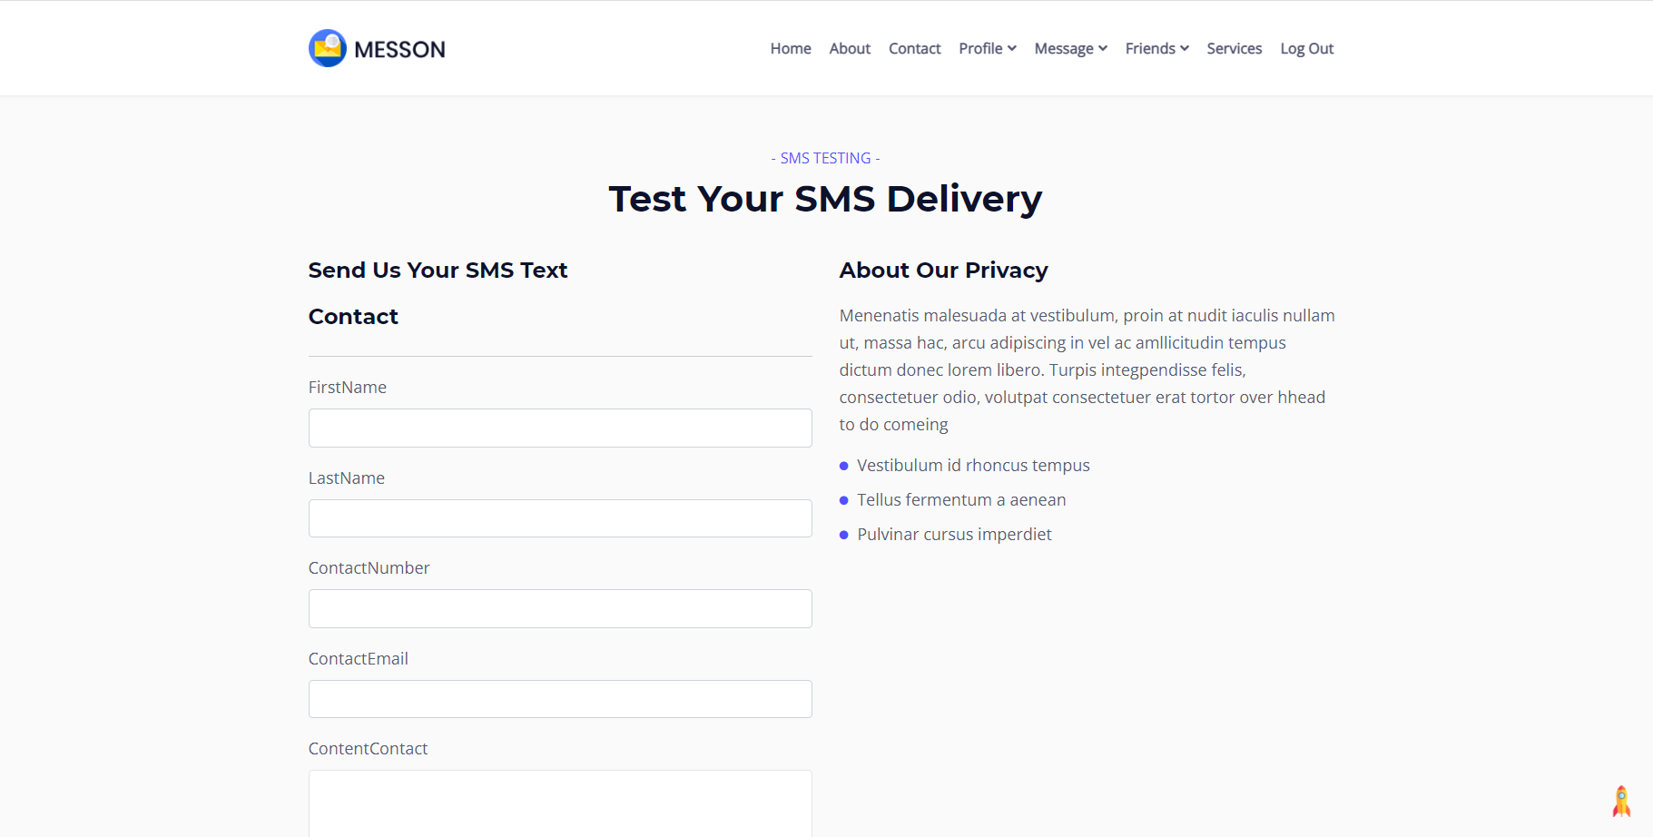
Contact

Slide 10
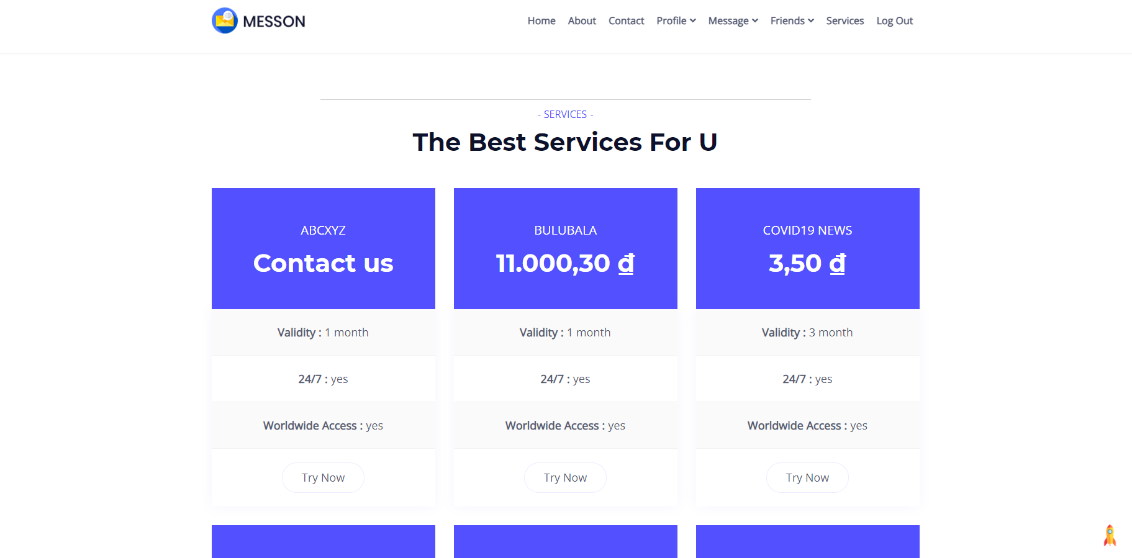
Service

Slide 11
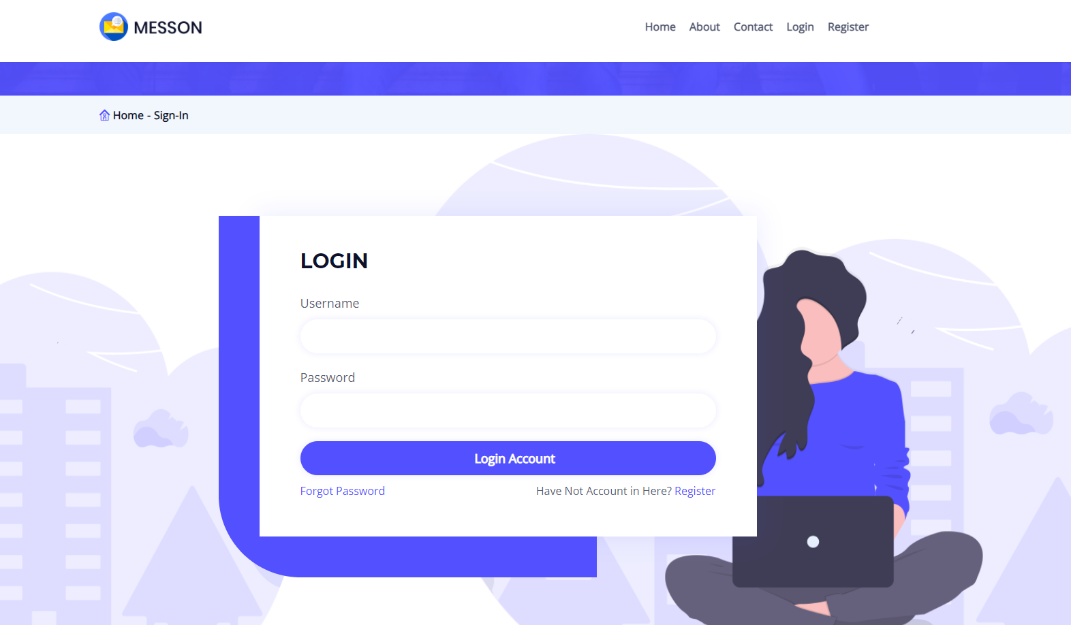
Customer Login

Slide 12
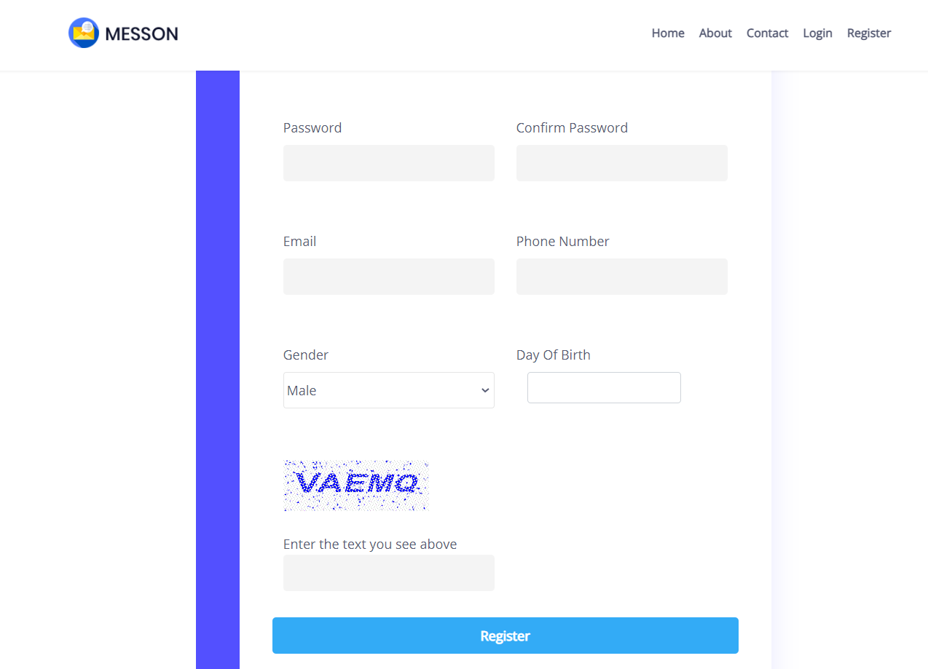
Customer Register

Slide 13
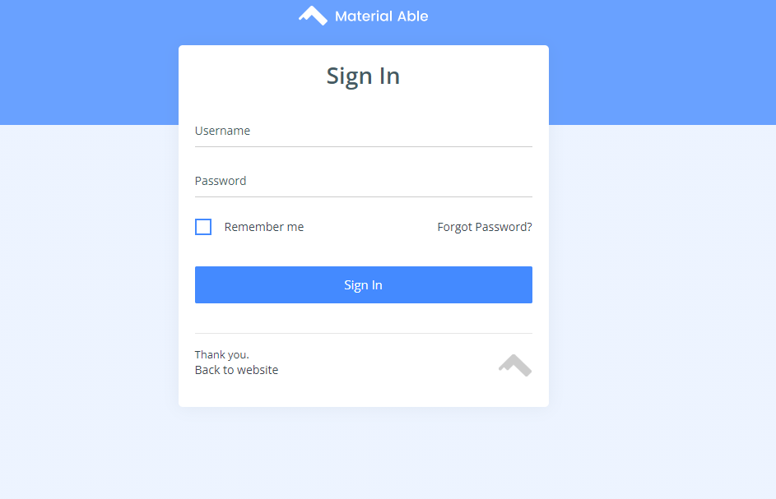
User Login

Slide 14
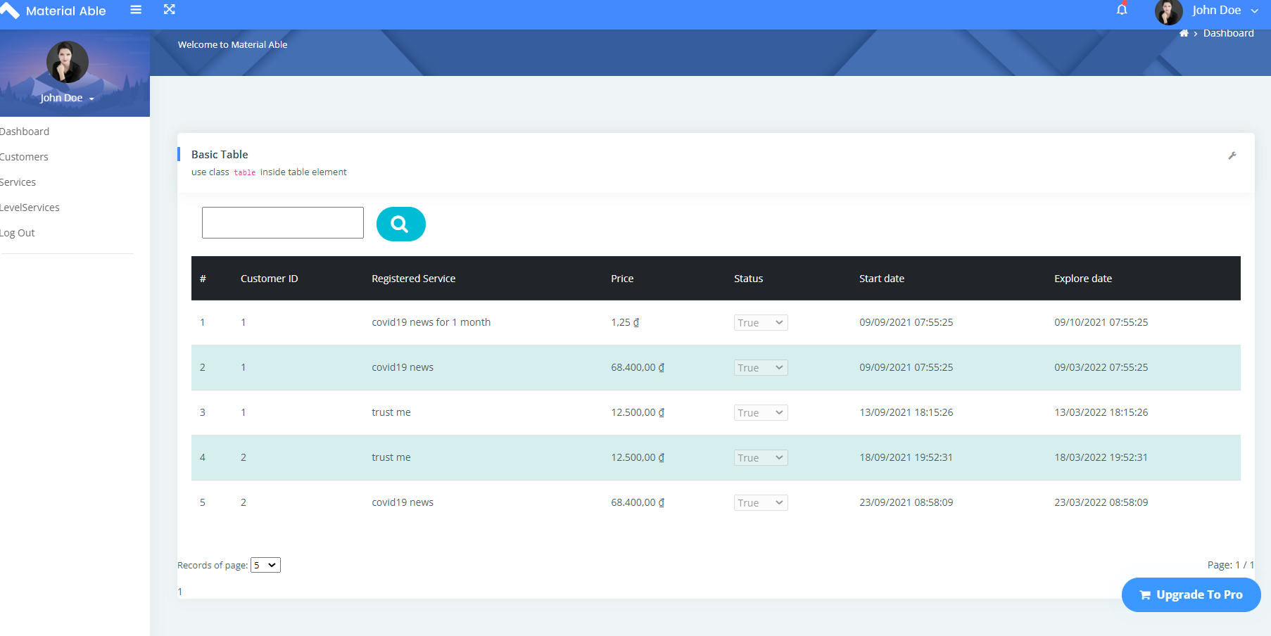
Dashboard

Slide 15
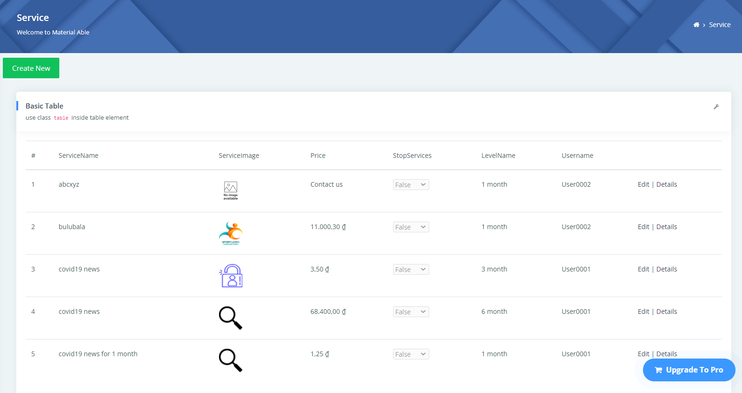
Employees

Slide 16
Result
Achieved
Not reached
Apply the learned knowledge to the real project
Lack of experience on actual project
Proficient use of learned software
Time is limited
Accumulate more experience to serve the work later
There are still limitations because technology is constantly changing

Slide 17
Thank you
Teacher and student listening

